Slide 1
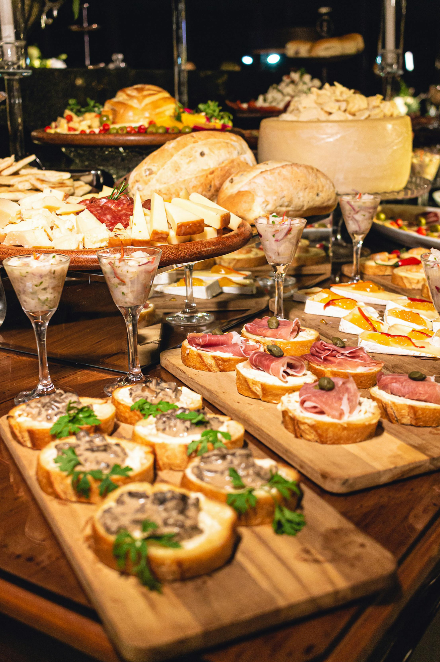
Restaurant Sales Analytics Dashboard
Performance Analysis • Menu Insights • Customer Behavior
Yummy Foods

Slide 2

Table of Contents
Objective
Methodology
Restaurant Performance
Menu Insights & Item Analysis
Detailed Order Breakdown
Insights & Recommendations
2

Slide 3
Objective
The objective of this project is to analyze the restaurant’s sales performance using SQL and Power BI, identify top selling items and categories, study customer ordering behavior, and uncover revenue trends.
3

Slide 4
Methodology
1. Defining the Business Problem
3. Exploratory Data Analysis
5. Data Visualization
Understanding what drives sales and customer demand
Explore data to undrstand trends
Visualize data with chart & dashboard
2. Data Preparing & Cleaning
4. Data Analysis
6. Insights & Recommendations
Creating KPIs, analyzing order behavior, evaluating pricing, and measuring category performance.
Cleaning data using SQL and Power Query (missing value, duplicate, validating date and price formats, etc)
Address insights and give recommendations from the analysis
4

Slide 5
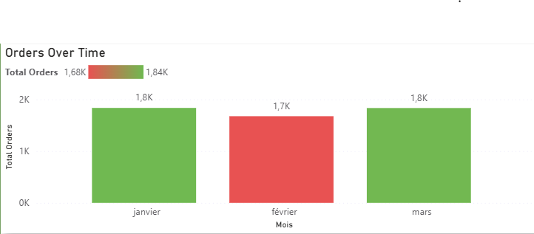
Restaurant Performance Overview
Orders over time by month
The restaurant recorded approximately 1.8K orders in January, followed by a slight decrease in February (1.65K orders), before recovering again in March (1.8K orders).
5

Slide 6
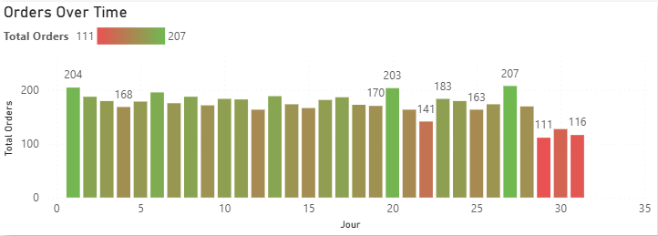
Restaurant Performance Overview
Orders over time by day
A recurring pattern is observed where orders peak at the beginning of each month, while sales consistently decline toward the end of the month.
6

Slide 7
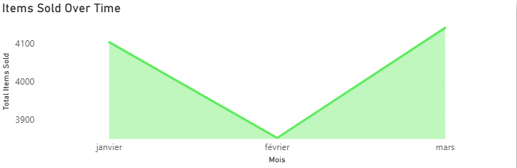
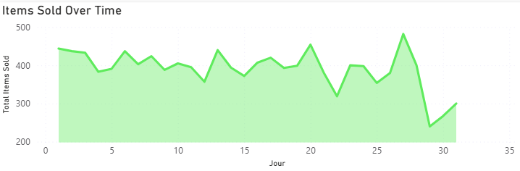
Items sold over time
  In terms of volume, January recorded 4,104 items sold, February dropped to 3,851, and March increased again to 4,142 items.
  Similar to order trends, item sales decrease toward the end of each month, but show strong peaks around days 13, 20, and 27.
This indicates predictable demand cycles and suggests opportunities to target promotions during low-activity end of month periods.
7

Slide 8
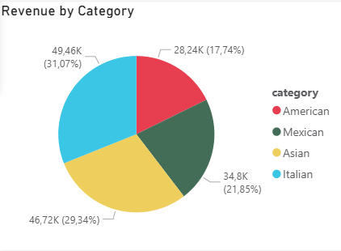
Revenue by Category
The Italian category generates the highest revenue, driven by both strong demand and higher priced dishes.
Other categories show moderate performance.
Lower activity periods suggest opportunities for promotions or special offers.
8

Slide 9
Key Performance Indicators
5k
12k
Total Orders
Total Items Sold
159,22 $
29,80
Total Revenue
Average Order Value
9

Slide 10
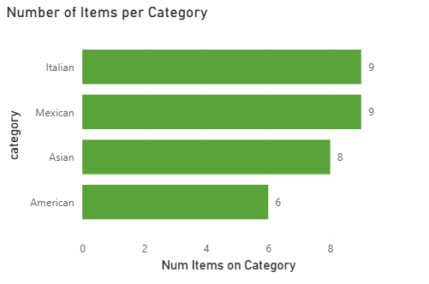
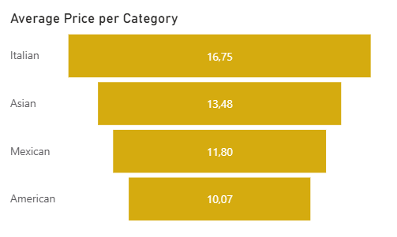
Menu Insights & Item Analysis
Average Price Per Ctageory
The Italian category has the highest average price at 16.75, followed by Asian 13.48, Mexican 11.80, and American 10.07.
10

Slide 11
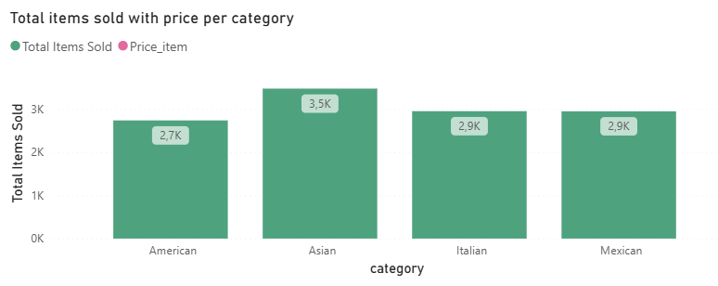
Total Items Sold vs Price per Category
  The Asian category leads in volume with approximately 3.5K items sold, making it the strongest category in terms of demand.
  Italian and Mexican categories follow closely with around 2.9K items sold each, while the American category records approximately 2.7K items sold.
This indicates that Asian dishes achieve an optimal balance between price and volume, while Italian dishes rely more on higher pricing than volume.
11

Slide 12
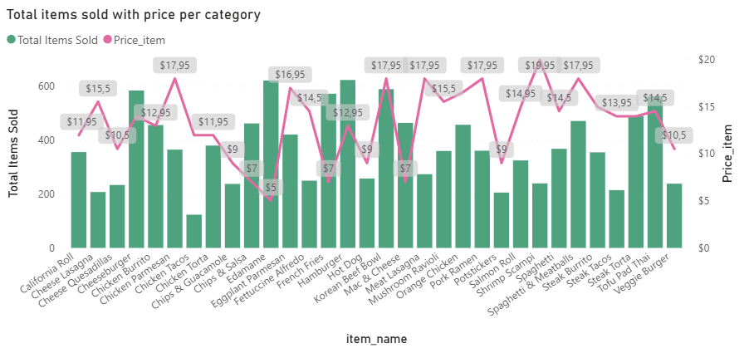
Total Items Sold vs Price per Category
  Items priced at 12.95 and 5.00 each reached 622 orders, showing strong appeal at both low and mid price points.
  Higher priced items such as 17.95 and 16.50 still achieved over 450–580 orders, proving that customers are willing to purchase premium items when perceived value is high.
  Mid priced items between 13.95 and 14.50 consistently appear among top sellers, indicating a strong customer preference for balanced price to value offerings.
12

Slide 13
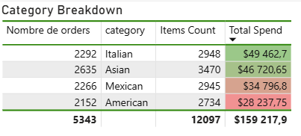
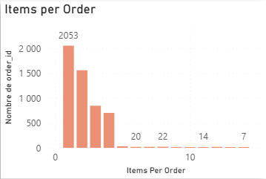
Detailed Order Breakdown
Premium categories, especially Italian, dominate high spend orders.
Most customers purchase 1–4 items per order, showing typical individual or small group ordering patterns.
13

Slide 14
Insights & Recommendations
13

Slide 15
Insights
1. Sales & Demand Patterns:
  Monthly orders remain relatively stable, with ~1.8K orders in January and March and a slight decline in February (1.65K orders).
  Orders and items sold consistently peak at the beginning and middle of the month, especially around days 1, 13, 20, and 27.
  A clear drop in sales occurs toward the end of each month, indicating predictable low-demand periods.
This shows that customer demand follows cyclical, time based behavior, likely influenced by salary periods or routine dining habits.
14

Slide 16
Insights
2. Category Performance:
  Asian cuisine is the top performing category by volume, with approximately 3.5K items sold, despite not having the highest average price.
  Italian cuisine has the highest average price (16.75) but slightly lower volume (~2.9K items sold), positioning it as a premium category.
  Mexican and American categories show moderate performance, with 2.9K and 2.7K items sold respectively, and lower average prices.
This indicates that volume driven categories (Asian) and price driven categories (Italian) contribute to revenue in different ways.
15

Slide 17
Insights
3. Pricing & Item-Level Performance:
  The most ordered items span a wide price range (5.00 to 17.95), proving that customers are willing to purchase both low-cost and premium items.
  Items priced around 12.95 and 5.00 reached the highest number of orders (622 orders each), showing strong mass appeal.
  Higher-priced items (16.50–17.95) still achieved 450+ orders, indicating strong perceived value rather than price sensitivity alone.
  Mid-priced items (13.95–14.50) consistently appear among top sellers.
Price alone does not drive demand, value perception and product appeal play a critical role.
16

Slide 18
Recommendations
1. Optimize Promotions Based on Demand Cycles:
  Introduce end of month promotions to counter recurring sales drops.
  Schedule targeted discounts or bundles around days 25–30, when demand is lowest.
2. Leverage High Performing Categories:
  Continue investing in Asian cuisine, as it combines strong volume with sustainable pricing.
  Highlight Italian dishes as premium offerings through chef specials or featured menu placements.
  Consider expanding high performing Asian and Italian items with variations or combo offers.
17

Slide 19
Recommendations
3. Improve Pricing Strategy:
  Reevaluate low selling, high priced items to assess whether price adjustments could increase demand.
  Avoid aggressive discounting on premium items that already perform well.
4. Operational & Inventory Optimization:
  Optimize staffing during high traffic days (early and mid month) to improve service speed.
  Reduce waste by adjusting inventory levels during predictable low demand periods.
5. Data-Driven Growth Opportunities:
  Use top selling items to design combo meals or loyalty rewards (coupons).
18

Slide 20
Thank you!

